Slide 1
Problem-solving strategies
Section 1.2
(Applying Polya’s Method)

Slide 2
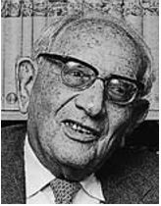
Polya’s Four-Step Problem-Solving Strategy
Understand the problem.
Devise a plan.
Carry out the plan.
Review the solution.

Slide 3
Let’s test polya’s methods
after all, we’re scientists-in-training…

Slide 4
Tournament scheduling (Solve a Similar but Simpler problem)
In a cricket league consisting of 10 teams, each team plays each of the other teams exactly three times. How many league games will be played?
Understand the Problem
Only for one round of games
Each team plays each of the other teams exactly once, so each team plays 3 games
Find the total number of games

Slide 5
Tournament scheduling (Solve a Similar but Simpler problem)
In a cricket league consisting of 10 teams, each team plays each of the other teams exactly three times. How many league games will be played?
Devise a Plan
4 teams, each of which has to play 3 other teams.
So, total number of matches = 4 x 3 = 12 ?
How many matches according to the diagram?
So, what is going on?
A
B
C
D
Notes:
Prompt the students to notice the different answers they get when they calculate and when they look at the diagram.
They should discuss to figure out which is the correct answer and why.

Slide 6
Tournament scheduling (Solve a Similar but Simpler problem)
In a cricket league consisting of 10 teams, each team plays each of the other teams exactly three times. How many league games will be played?
Carry Out the Plan
Total matches for 4 teams, each playing the other 3 teams once = (4 x 3) / 2
= 12 / 2 = 6
For 10 teams?
Notes:
Having figured out the correct answer for 4 teams, they should try the same logic for 10 teams.

Slide 7
Tournament scheduling (Solve a Similar but Simpler problem)
In a cricket league consisting of 10 teams, each team plays each of the other teams exactly three times. How many league games will be played?
Review the solution
Games played by first team = 9
Games played by second team = 8
Games played by second team = ?
Total number of games = 9 + 8 + ? + ? + …. + ? = ?
Notes:
The review of the solution is an opportunity to use a different way to count the total number of matches.

Slide 8
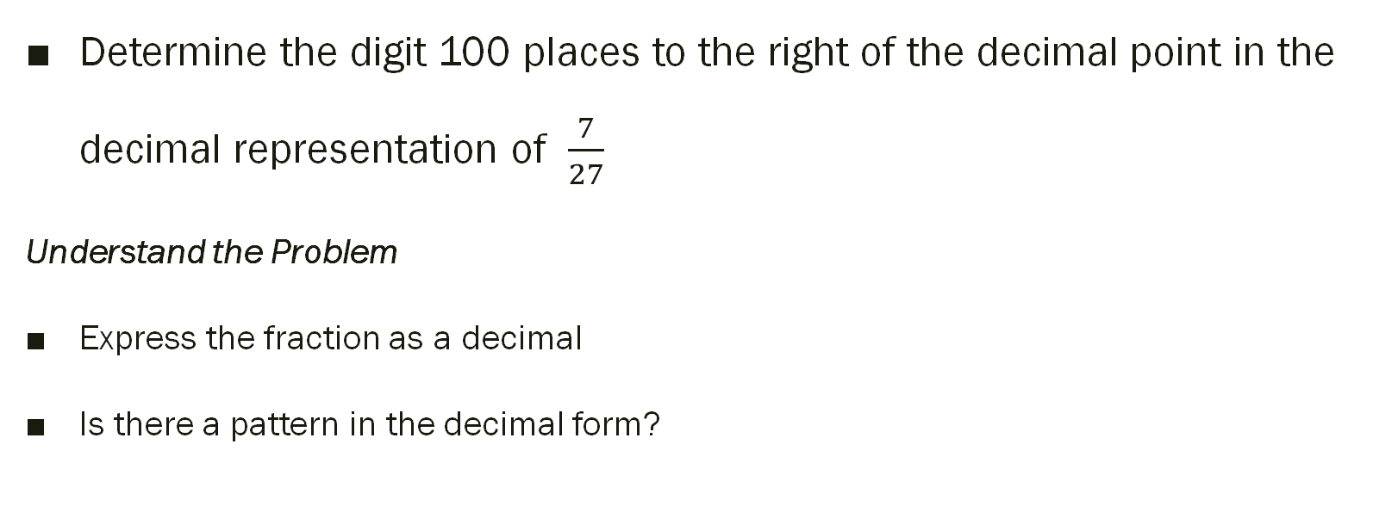
Recurring decimals (Make a table and look for a pattern)
Determine the digit 100 places to the right of the decimal point in the decimal representation of $\frac{7}{27}$
Understand the Problem
Express the fraction as a decimal
Is there a pattern in the decimal form?

Slide 9
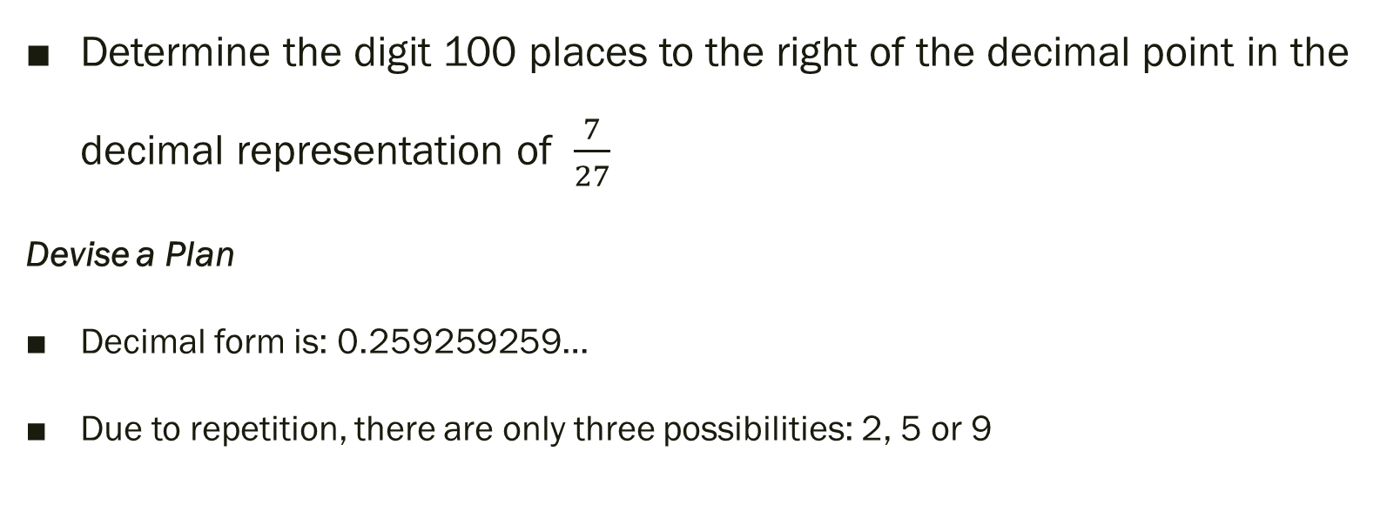
Recurring decimals (Make a table and look for a pattern)
Determine the digit 100 places to the right of the decimal point in the decimal representation of $\frac{7}{27}$
Devise a Plan
Decimal form is: 0.259259259…
Due to repetition, there are only three possibilities: 2, 5 or 9
Notes:
Link: https://www.youtube.com/watch?v=hESOLhgrrcE

Slide 10
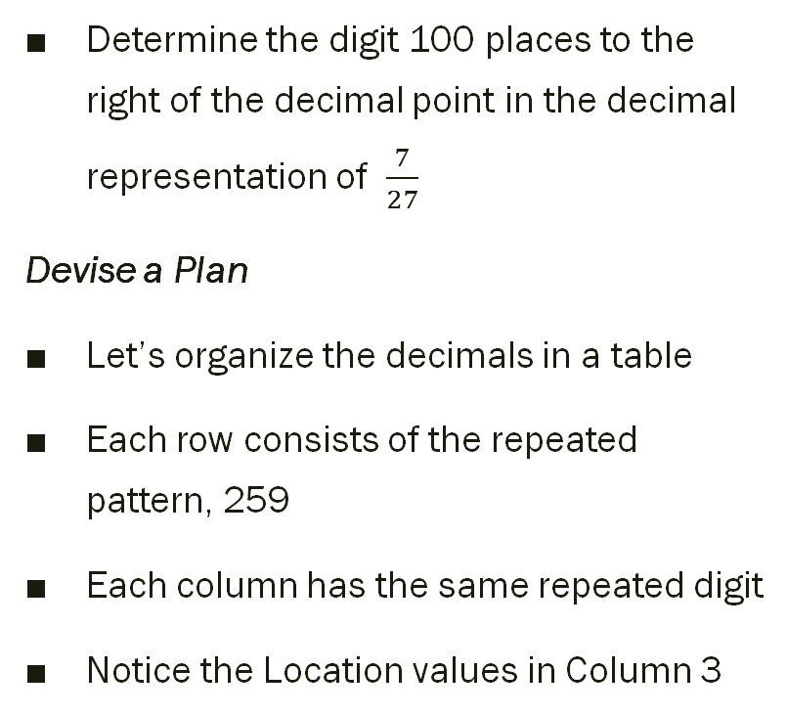
Recurring decimals (Make a table and look for a pattern)
Determine the digit 100 places to the right of the decimal point in the decimal representation of $\frac{7}{27}$
Devise a Plan
Let’s organize the decimals in a table
Each row consists of the repeated pattern, 259
Each column has the same repeated digit
Notice the Location values in Column 3
Column 1 Location Digit | Column 2 Location Digit | Column 3 Location Digit
1st 2 | 2nd 5 | 3rd 9
4th 2 | 5th 5 | 6th 9
7th 2 | 8th 5 | 9th 9
10th 2 | 11th 5 | 12th 9
13th 2 | 14th 5 | 15th 9
. | . | .
. | . | .

Slide 11
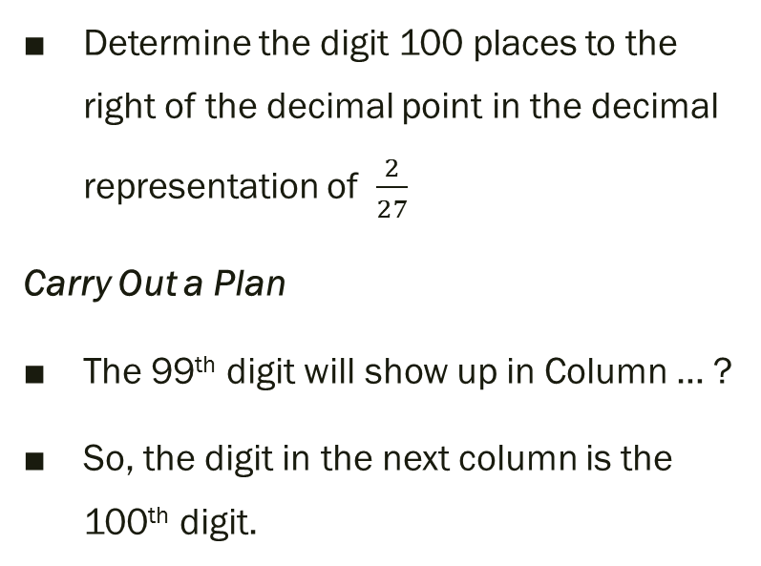
Recurring decimals (Make a table and look for a pattern)
Determine the digit 100 places to the right of the decimal point in the decimal representation of $\frac{2}{27}$
Carry Out a Plan
The 99th digit will show up in Column … ?
So, the digit in the next column is the 100th digit.
Column 1 Location Digit | Column 2 Location Digit | Column 3 Location Digit
1st 2 | 2nd 5 | 3rd 9
4th 2 | 5th 5 | 6th 9
7th 2 | 8th 5 | 9th 9
10th 2 | 11th 5 | 12th 9
13th 2 | 14th 5 | 15th 9
. | . | .
. | . | .
Notes:
The 99th digit will show up in Column 3.
So, the 100th digit will show up in Column 1. So, the 100th digit is 2.

Slide 12
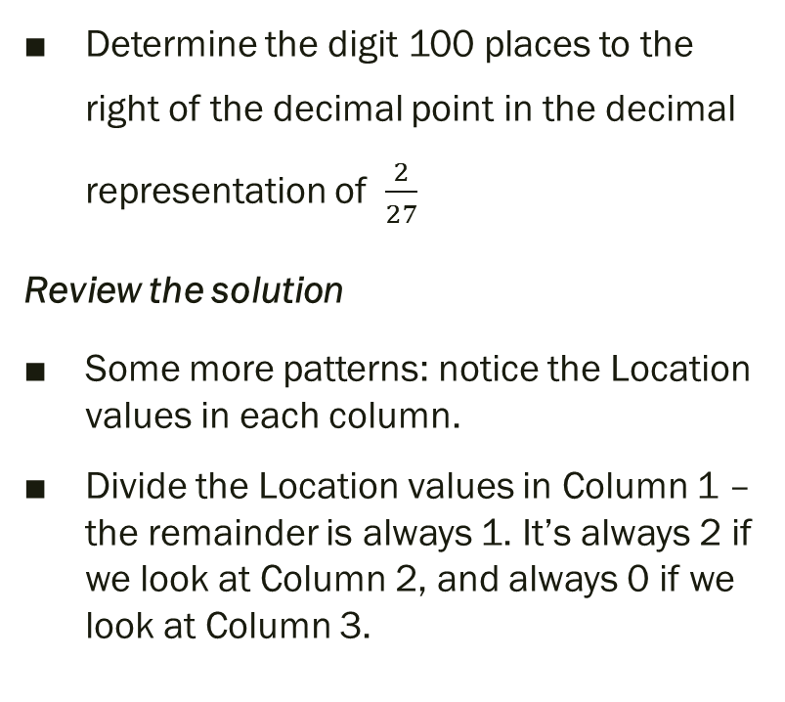
Recurring decimals (Make a table and look for a pattern)
Determine the digit 100 places to the right of the decimal point in the decimal representation of
Review the solution
Some more patterns: notice the Location values in each column.
Divide the Location values in Column 1 – the remainder is always 1. It’s always 2 if we look at Column 2, and always 0 if we look at Column 3.
Column 1 Location Digit | Column 2 Location Digit | Column 3 Location Digit
1st 2 | 2nd 5 | 3rd 9
4th 2 | 5th 5 | 6th 9
7th 2 | 8th 5 | 9th 9
10th 2 | 11th 5 | 12th 9
13th 2 | 14th 5 | 15th 9
. | . | .
. | . | .
Notes:
Call out students to do the divisions… such as ”what is the remainder when we divide 11 by 3?” or “what is the remainder when we divide 13 by 3?” and so on…

Slide 13
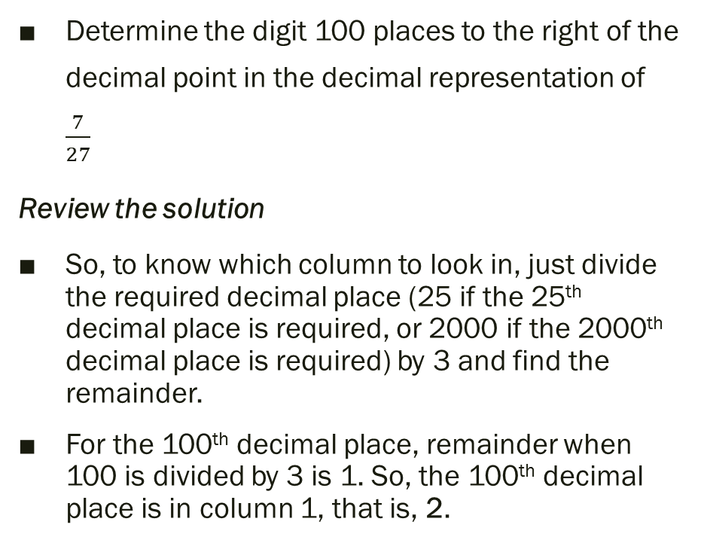
Recurring decimals (Make a table and look for a pattern)
Determine the digit 100 places to the right of the decimal point in the decimal representation of $\frac{7}{27}$
Review the solution
So, to know which column to look in, just divide the required decimal place (25 if the 25th decimal place is required, or 2000 if the 2000th decimal place is required) by 3 and find the remainder.
For the 100th decimal place, remainder when 100 is divided by 3 is 1. So, the 100th decimal place is in column 1, that is, 2.
Column 1 Location Digit | Column 2 Location Digit | Column 3 Location Digit
1st 2 | 2nd 5 | 3rd 9
4th 2 | 5th 5 | 6th 9
7th 2 | 8th 5 | 9th 9
10th 2 | 11th 5 | 12th 9
13th 2 | 14th 5 | 15th 9
. | . | .
. | . | .

Slide 14
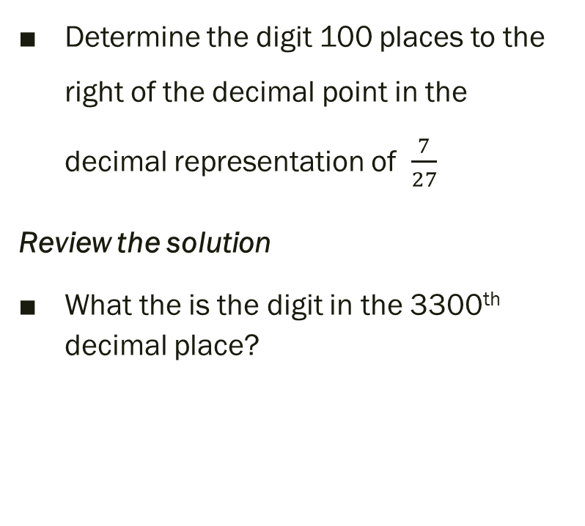
Recurring decimals (Make a table and look for a pattern)
Determine the digit 100 places to the right of the decimal point in the decimal representation of $\frac{7}{27}$
Review the solution
What the is the digit in the 3300th decimal place?
Column 1 Location Digit | Column 2 Location Digit | Column 3 Location Digit
1st 2 | 2nd 5 | 3rd 9
4th 2 | 5th 5 | 6th 9
7th 2 | 8th 5 | 9th 9
10th 2 | 11th 5 | 12th 9
13th 2 | 14th 5 | 15th 9
. | . | .
. | . | .
Notes:
The 99th digit will show up in Column 3.
So, the 100th digit will show up in Column 1. So, the 100th digit is 2.

Slide 15

Monopoly (Work backwards)
In consecutive turns of a Monopoly game, Samina first paid $800 for a hotel. She then lost half her money when she landed on Boardwalk. Next, she collected $200 for passing GO. She then lost half her remaining money when she landed on Illinois Avenue. Samina now has $2500. How much did she have just before she purchased the hotel?
Understand the problem
How much money did Samina have just before she bought the hotel?
Notes:
https://www.youtube.com/watch?v=-TFn_7g_mwY

Slide 16
Monopoly (Work backwards)
In consecutive turns of a Monopoly game, Samina first paid $800 for a hotel. She then lost half her money when she landed on Boardwalk. Next, she collected $200 for passing GO. She then lost half her remaining money when she landed on Illinois Avenue. Samina now has $2500. How much did she have just before she purchased the hotel?
Devise a Plan
We could try using algebra, but let’s try a simpler way.
Each time there is a change in Samina’s wealth, we are told how much she has after the change and how much the change is, either in absolute terms (e.g. $200) or in relative terms (e.g., half her money).
So we can actually work backwards.

Slide 17
Monopoly (Work backwards)
In consecutive turns of a Monopoly game, Samina first paid $800 for a hotel. She then lost half her money when she landed on Boardwalk. Next, she collected $200 for passing GO. She then lost half her remaining money when she landed on Illinois Avenue. Samina now has $2500. How much did she have just before she purchased the hotel?
Carry out the Plan
When Samina landed on Illinois Avenue, she lost half her money and now has $2500. So, she must have double that amount before that turn, that is, $5000.
Before passing Go, she must have had $5000 - $200 = $4800
Before landing on Boardwalk, she must have had twice of $4800, that is, $9600.
Before purchasing the hotel, she must have had 9600 + 800 = $10,400

Slide 18
Monopoly (Work backwards)
In consecutive turns of a Monopoly game, Samina first paid $800 for a hotel. She then lost half her money when she landed on Boardwalk. Next, she collected $200 for passing GO. She then lost half her remaining money when she landed on Illinois Avenue. Samina now has $2500. How much did she have just before she purchased the hotel?
Review the solution
Work forwards:
10400 – 800 = 9600 (purchased hotel)
9600 / 2 = 4800 (landed on Boardwalk)
4800 + 200 = 5000 (passed Go)
5000 / 2 = 2500 (landed on Illinois Avenue)

Slide 19
Monopoly (Work backwards)
In consecutive turns of a Monopoly game, Samina first paid $800 for a hotel. She then lost half her money when she landed on Boardwalk. Next, she collected $200 for passing GO. She then lost half her remaining money when she landed on Illinois Avenue. Samina now has $2500. How much did she have just before she purchased the hotel?
Review the solution
Challenge: verify the solution using algebra
Notes:
½ * [ ½ * (S – 800) + 200 ] = 2500

Slide 20
The Question of Age (Guess and check)
The product of the ages, in years, of three teenagers is 4590. None of the teens are the same age. What are the ages of the teenagers?
Understand the problem
The set of possibilities is quite small: {13, 14, 15, 16, 17, 18, 19}
Three distinct (that is, different) numbers must be chosen from this set
Their product must be 4590

Slide 21
The Question of Age (Guess and check)
The product of the ages, in years, of three teenagers is 4590. None of the teens are the same age. What are the ages of the teenagers?
Devise a Plan
xyz = 4590 (but this is not very helpful)
As the product 4590 ends in 0, we know that 2 and 5 are present in its list of factors
So, 15 must be there.
Let’s guess and check the rest of the possibilities

Slide 22
The Question of Age (Guess and check)
The product of the ages, in years, of three teenagers is 4590. None of the teens are the same age. What are the ages of the teenagers?
Carry out the Plan
13 . 14 . 15 = 2730 (much too small)
15 . 18 . 19 = 5130 (larger than target, but not only by about 500)
Possibilities are: {15, 16, 17}, {15, 16, 18}, {15, 16, 19}, {15, 17, 18}
15 . 17 . 18 = 4590 – bingo!

Slide 23

The Question of Age (Guess and check)
The product of the ages, in years, of three teenagers is 4590. None of the teens are the same age. What are the ages of the teenagers?
Review the solution
We can check that none of the other numbers {13, 14, 16, 19} is a factor of 4590.
Our guessing was efficient because we first checked the lower end, then the highest end, and then intelligently replaced 19 with 17. This idea is the basis of the “prune and search” method used in designing optimization algorithms.

Slide 24
Child’s Play (Look for a pattern)
Find the sum of the first 100 natural numbers
Understand the problem
We have to find the result of:
1 + 2 + 3 + 4 + … + 97 + 98 + 99 + 100
Notes:
https://www.youtube.com/watch?v=FV5Ol5qM-mw

Slide 25
Child’s Play (Look for a pattern)
Find the sum of the first 100 natural numbers
Gauss’ Plan
Instead of adding up all the numbers one by one, Gauss noticed that if he paired the numbers intelligently, he got a pattern:
1 + 100 = 101
2 + 99 = 101
3 + 98 = 101
4 + 97 = 101
He reasoned that sum of each pair all the way to 50 + 51 would give 101. How could he be so sure?
x + (___ - x) = 101

Slide 26
Child’s Play (Look for a pattern)
Find the sum of the first 100 natural numbers
Gauss’ Plan
This is the deductive proof that the sum of each pair is the same as the sum of the first number and the last number of the series.
Ascending: | 1 | 2 | 3 | … | 98 | 99 | 100
Descending: | 100 | 99 | 98 | … | 3 | 2 | 1
Pair-wise sums | (1+100) | (2+99) | (3+98) | … | (98+3) | (99+2) | (100+1)
Analysis | (1+100) | (1+1) + (100-1) | (2+1) + (99-1) | … | (97+1)+(4-1) | (98+1)+(3-1) | (99+1)+(2-1)
 | (1+100) | (1+100)+(1-1) | (2+99)+(1-1) | … | (97+4)+(1-1) | (98+3)+(1-1) | (99+2)+(1-1)
 | (1+100) | (1+100)+(0) | (2+99)+(0) | … | (97+4)+(0) | (98+3)+(0) | (99+2)+(0)
 | 101 | 101 | 101 | … | 101 | 101 | 101

Slide 27
Child’s Play (Look for a pattern)
Find the sum of the first 100 natural numbers
Gauss Carries out his Plan
Since the sum of each pair is 101, to find the sum of all the pairs, all he needed was to figure out how many pairs there were.
How many pairs are there?

Slide 28
Child’s Play (Look for a pattern)
Find the sum of the first 100 natural numbers
Gauss Carries out his Plan
Since the sum of each pair is 101, to find the sum of all the pairs, all he needed was to figure out how many pairs there were.
How many pairs are there?
There are 100 pairs as he was summing numbers from 1 to 100.
Sum of all pairs: (101) * (100)
But, the sum of all pairs = (1+2+…+99+100)+(100+99+…+2+1)
Since each pair contains one number from the series in ascending order and one number from the same series in descending order

Slide 29
Child’s Play (Look for a pattern)
Find the sum of the first 100 natural numbers
Gauss Carries out his Plan
Sum of all pairs: (101) * (100)
But, the sum of all pairs = (1+2+…+99+100)+(100+99+…+2+1)
Let’s use S to represent the sum (1+2+…+99+100)
So, (1+2+…+99+100)+(100+99+…+2+1) = S + S = 2S
So, (101) * (100) = 2S
2S = (101) * (100)
=> S = (101) * (100) / 2
=> S = 101 * 50 = 5050

Slide 30
Child’s Play (Look for a pattern)
Find the sum of the first 100 natural numbers
Review the solution
There is nothing special about the first 100 natural numbers
There is nothing special about the method – we can apply it to any sequence of numbers that increase steadily by 1
So, we can extend this solution to the sum of the first n Natural Numbers:
1 + 2 + 3 + … + (n - 2) + (n - 1) + n = n (n + 1)/2

Slide 31
A Deceptive Problem (Write an equation)
A kameez and an achkan together cost Rs 10,000. The achkan costs Rs 9,000 more than the kameez. What are the cost of the kameez and the cost of the achkan?
Understand the problem
We have to find two numbers whose sum is 10000 and whose difference is 9000.
Which one is more expensive – the kameez or the achkan?
It is NOT 9000 and 1000, as 9000 – 1000 = 8000.

Slide 32
A Deceptive Problem (Write an equation)
A kameez and an achkan together cost Rs 10,000. The achkan costs Rs 9,000 more than the kameez. What are the cost of the kameez and the cost of the achkan?
Devise a Plan
Represent the cost of the kameez by k and the cost of the achkan by a
k + a = 10000
a – k = 9000
=> a = 9000 + k

Slide 33
A Deceptive Problem (Write an equation)
A kameez and an achkan together cost Rs 10,000. The achkan costs Rs 9,000 more than the kameez. What are the cost of the kameez and the cost of the achkan?
Carry out the Plan
k + a = 10000
a – k = 9000 => a = 9000 + k
Substituting for a: k + (9000 + k) = 10000 => 2k + 9000 = 10000

Slide 34
A Deceptive Problem (Write an equation)
A kameez and an achkan together cost Rs 10,000. The achkan costs Rs 9,000 more than the kameez. What are the cost of the kameez and the cost of the achkan?
Carry out the Plan
2k + 9000 = 10000 => 2k = 10000 – 1000 => 2k = 1000
=> k = 500
Now calculating a: a = 9000 + 500 = 9500

Slide 35
A Deceptive Problem (Write an equation)
A kameez and an achkan together cost Rs 10,000. The achkan costs Rs 9,000 more than the kameez. What are the cost of the kameez and the cost of the achkan?
Review the solution
We can easily verify that:
500 + 9500 = 10000
9500 – 500 = 9000

Slide 36
Graphs –powerful visuals for reasoning
Reading and Interpreting Graphs

Slide 37
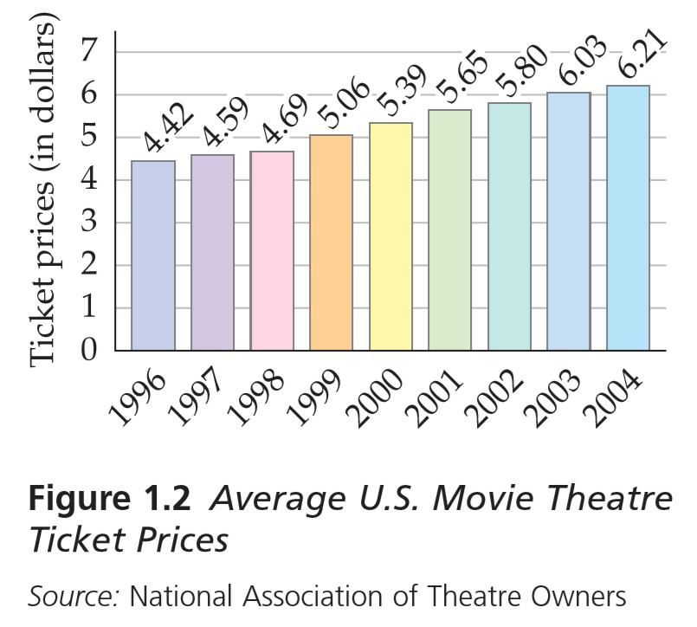
Bar graphs
Two axes:
One increasing from left to right
One increasing from bottom to top
Ticket prices are represented as bars, one for each year from 1996 to 2004
The taller a bar, the higher the average ticket price in that year

Slide 38
Check your understanding
Determine the minimum average U.S. movie theatre ticket price for the years from 1996 to 2004.
Determine the maximum average U.S. movie theatre ticket price for the years from 1996 to 2004.

Slide 39
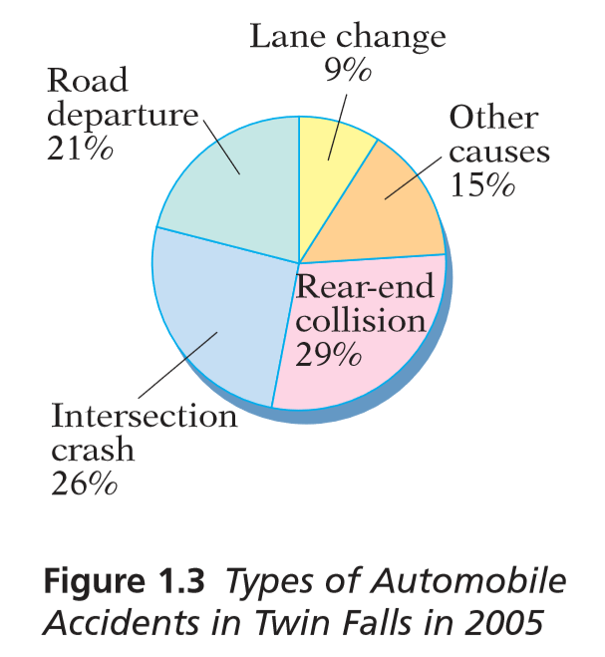
Circle graphs
No axes, rather parts of a circle, called sectors
The bigger a sector, the higher the share of that type of accident in that city in 2005

Slide 40
Check your understanding
Estimate the number of rear-end collisions that occurred in Twin Falls in the year 2005.
Determine the number of lane change accidents that occurred in Twin Falls in the year 2005.
Note: The total number of accidents in Twin Falls for the year 2005 was 4300.

Slide 41
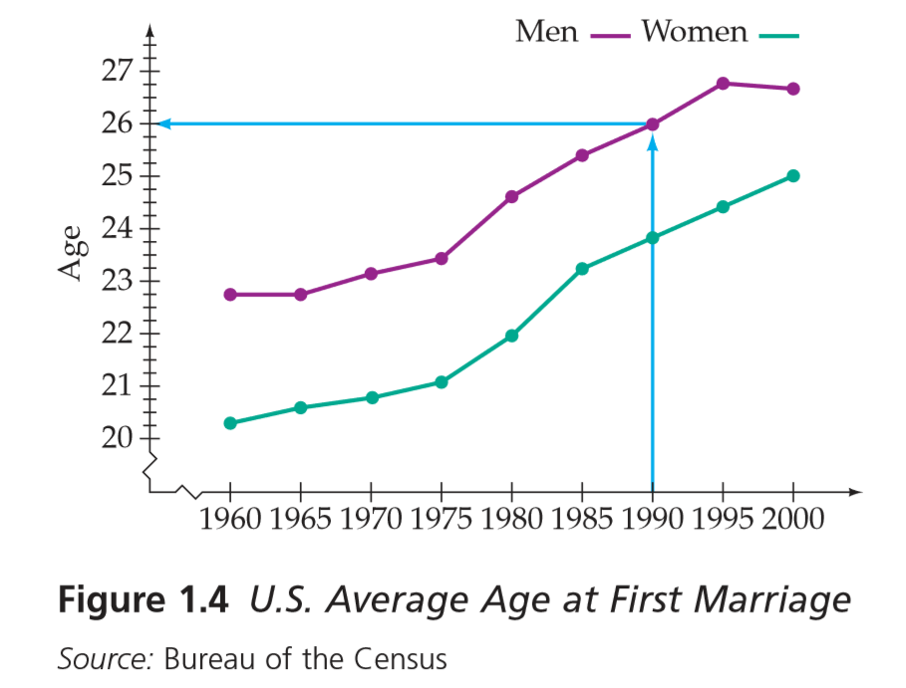

Broken-line graphs
Two axes:
One increasing from left to right
One increasing from bottom to top
Average age at time of marriage, in each year:
green dots for women
maroon dots for men
Lines between dots indicate trends
- this symbol indicates that values less than the first are not being shown in the graph
Notes:
Point out that there are three smaller markers between each year marker. These indicate quarters of the year.

Slide 42
Check your understanding
Estimate the average age at which women married for the first time in the year 2000. Round to the nearest quarter of a year.
Estimate the average ages at first marriage for men and for women in the year 1975. Round to the nearest quarter of a year.

Slide 43
Additional Questions
for training and assessment

Slide 44

City Blocks (basic variant)
A
Alia wants to walk from point A (top-right of map) to point B (bottom-left of map).
How many direct routes can Alia take?
Soluton: you remember path problem we solved in last class?
B
© OpenStreetMap contributors

Slide 45
City Blocks (variant with twist - 1)
A
Alia wants to walk from point A (top-right of map) to point B (bottom-left of map), passing by point C.
How many direct routes can Alia take?
Soluton
C
B
© OpenStreetMap contributors

Slide 46
City Blocks (variant with twist - 2)
A
Alia wants to walk from point A (top-right of map) to point B (bottom-left of map), passing by point D.
How many direct routes can Alia take?
Soluton
B
D
© OpenStreetMap contributors

Slide 47
City Blocks (variant with twist - 3)
A
Alia wants to walk from point A (top-right of map) to point B (bottom-left of map), avoiding points C and D.
How many direct routes can Alia take?
Soluton
C
B
D
© OpenStreetMap contributors

Slide 48
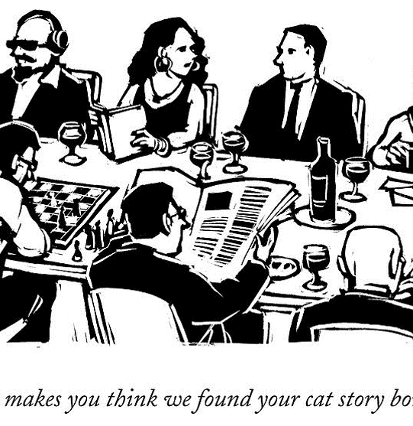
The handshaking problem
If six people greet each other at a party by shaking hands with one another, how many handshakes will take place?
Hint: try with two people and add third person and then 4th person to see changes and pattern.

Slide 49
The bigger handshaking problem
How many handshakes will take place, if there are 100 people at Gauss’ party?

Slide 50
Diophantus’ Epigram
Nothing is known about the personal life of the ancient Greek mathematician Diophantus except for the information in the following epigram.
“Diophantus passed 1/6 of his life in childhood, 1/12 in youth, and 1/7 more as a bachelor. Five years after his marriage was born a son who died four years before his father, at 1/2 his father’s (final) age.”
How old was Diophantus when he died?
Notes:
Draw a timeline
Consider the denominators in the given fractions…
Make intelligent guesses

Slide 51
Diophantus’ Epigram
Nothing is known about the personal life of the ancient Greek mathematician Diophantus except for the information in the following epigram.
“Diophantus passed 1/6 of his life in childhood, 1/12 in youth, and 1/7 more as a bachelor. Five years after his marriage was born a son who died four years before his father, at 1/2 his father’s (final) age.”
X = Childhood + Youth + bachelor + Marriage + sons age + 4
X = 1/6x + 1/12x+ 1/7x + 5 +1/2x+4
How old was Diophantus when he died?
Notes:
Draw a timeline
Consider the denominators in the given fractions…
Make intelligent guesses

